Slide 1
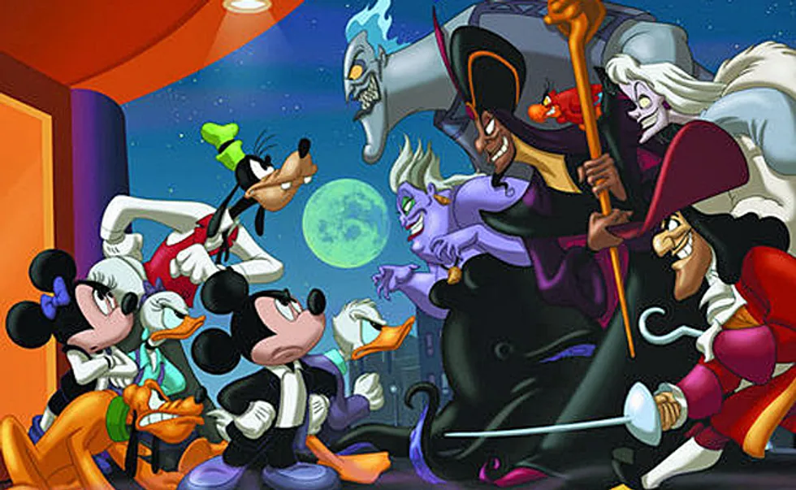
Hero or Villain?
By John Pang

Slide 2
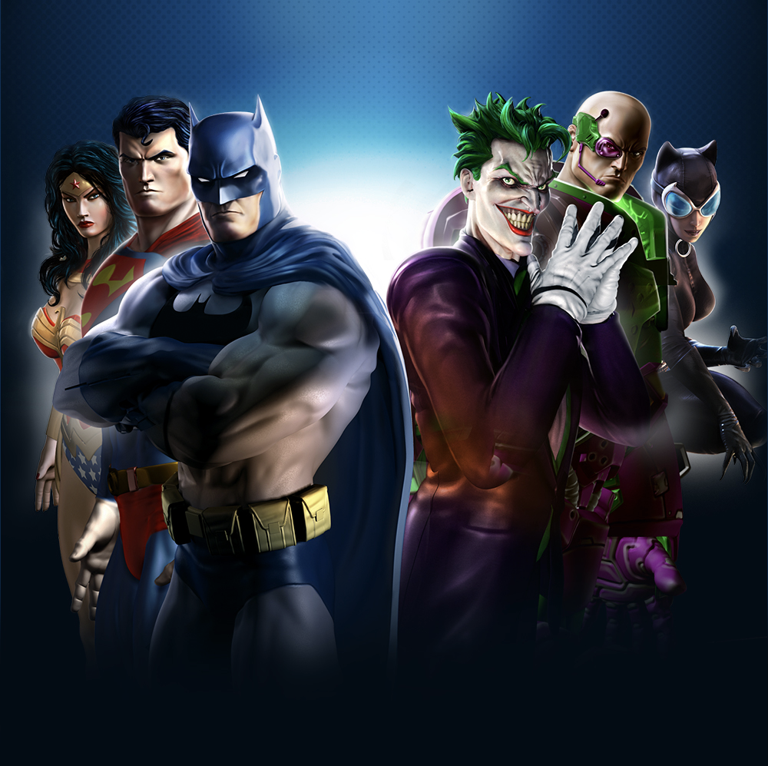
Can Convolutional Neural Networks (CNN), a Machine Learning Model using image recognition and processing, accurately identify an image as Hero or Villain?

Slide 3
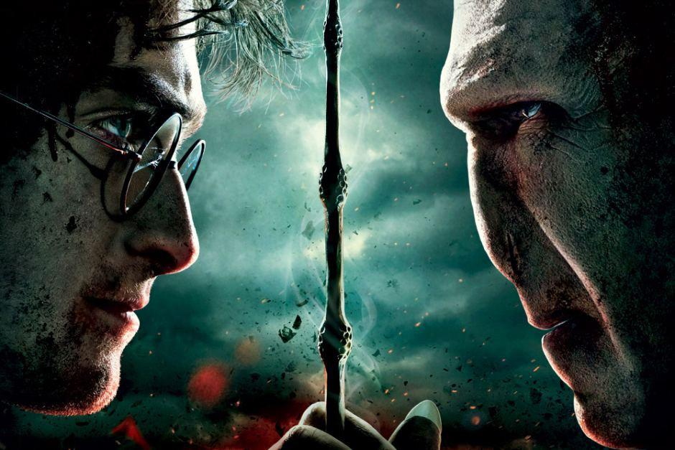
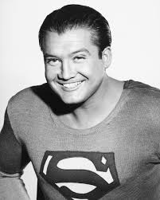
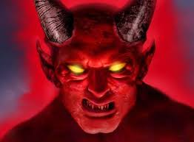
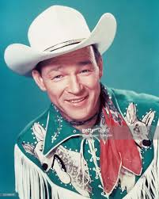
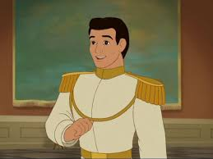
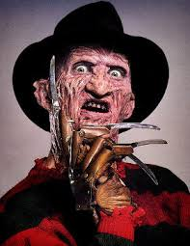
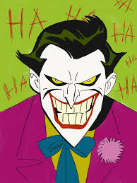
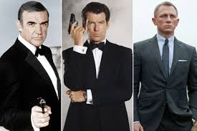
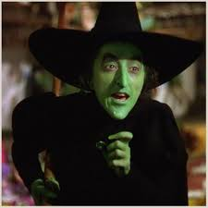
Defining traditional Heroes and Villains:
Early depiction of Villains (Satan, Wicked Witch, Joker)
Early depiction of Heroes (Superman, Disney archetype heroes)
Main traits are goodness, trustworthiness, courage, and honesty.
Clean shaven, not bald, physically fit, lighter complexion, new haircut.
Hero’s clothing had lighter and brighter colors, clean, rounded edges.
Main traits are dishonesty, cruelty, criminality and evilness.
Pronounced pointed facial features, facial hair, long hair, darker skin tones, thick eyebrows, overweight and bald.
Examples of villain clothing darker clothing, jagged edges in costumes, and torn clothing.

Slide 4
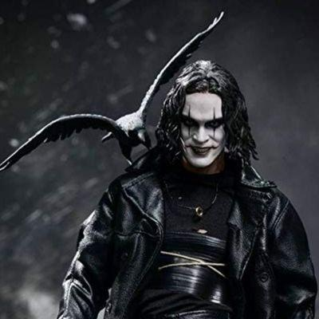
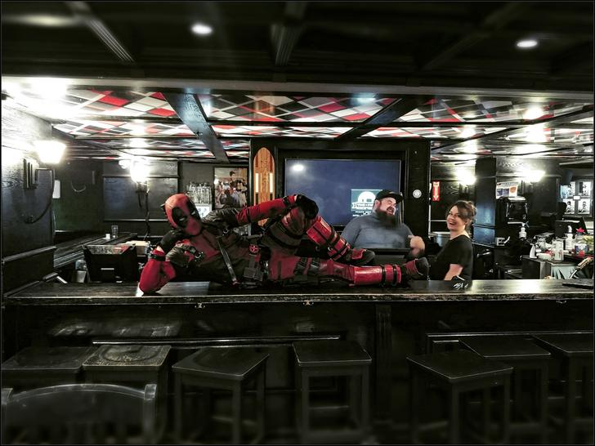
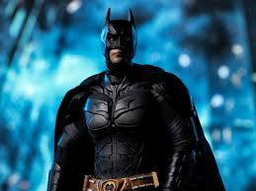
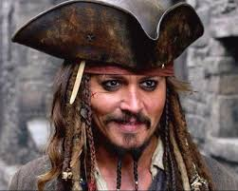
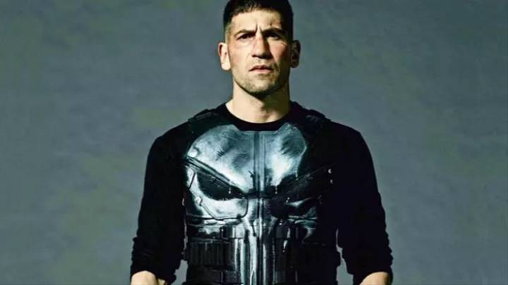
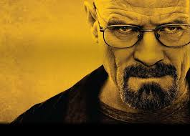
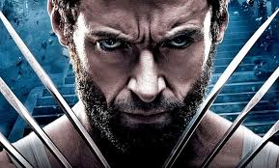
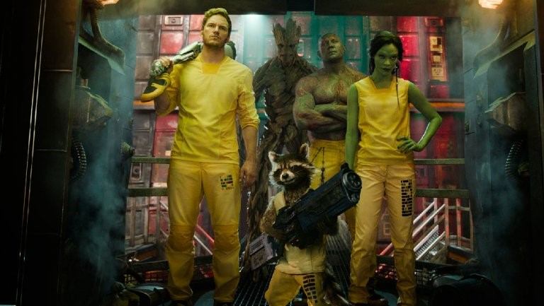
Rise of the Antiheroes (Guardians of the Galaxy / Deadpool / Captain Jack Sparrow)
Character redemption from selfishness to world/universe savior. Good hearted, fluid morality / not perfect, occasionally commit crimes.
Character redemption from selfishness to world/universe savior. Good hearted, fluid morality / not perfect, occationally commit crimes.
Tendency to wear darker color clothing.
Tendency to wear darker color clothing.
Facial features closely resemble villains( scowl, dark makeup, facial hair)
Facial features closely resemble villains( scowl, dark makeup, facial hair)
Depiction of chaos and violence in the antihero’s environment.

Slide 5
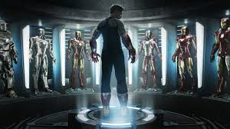
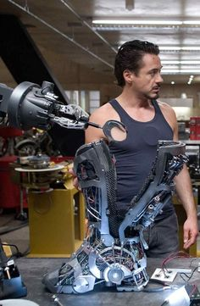
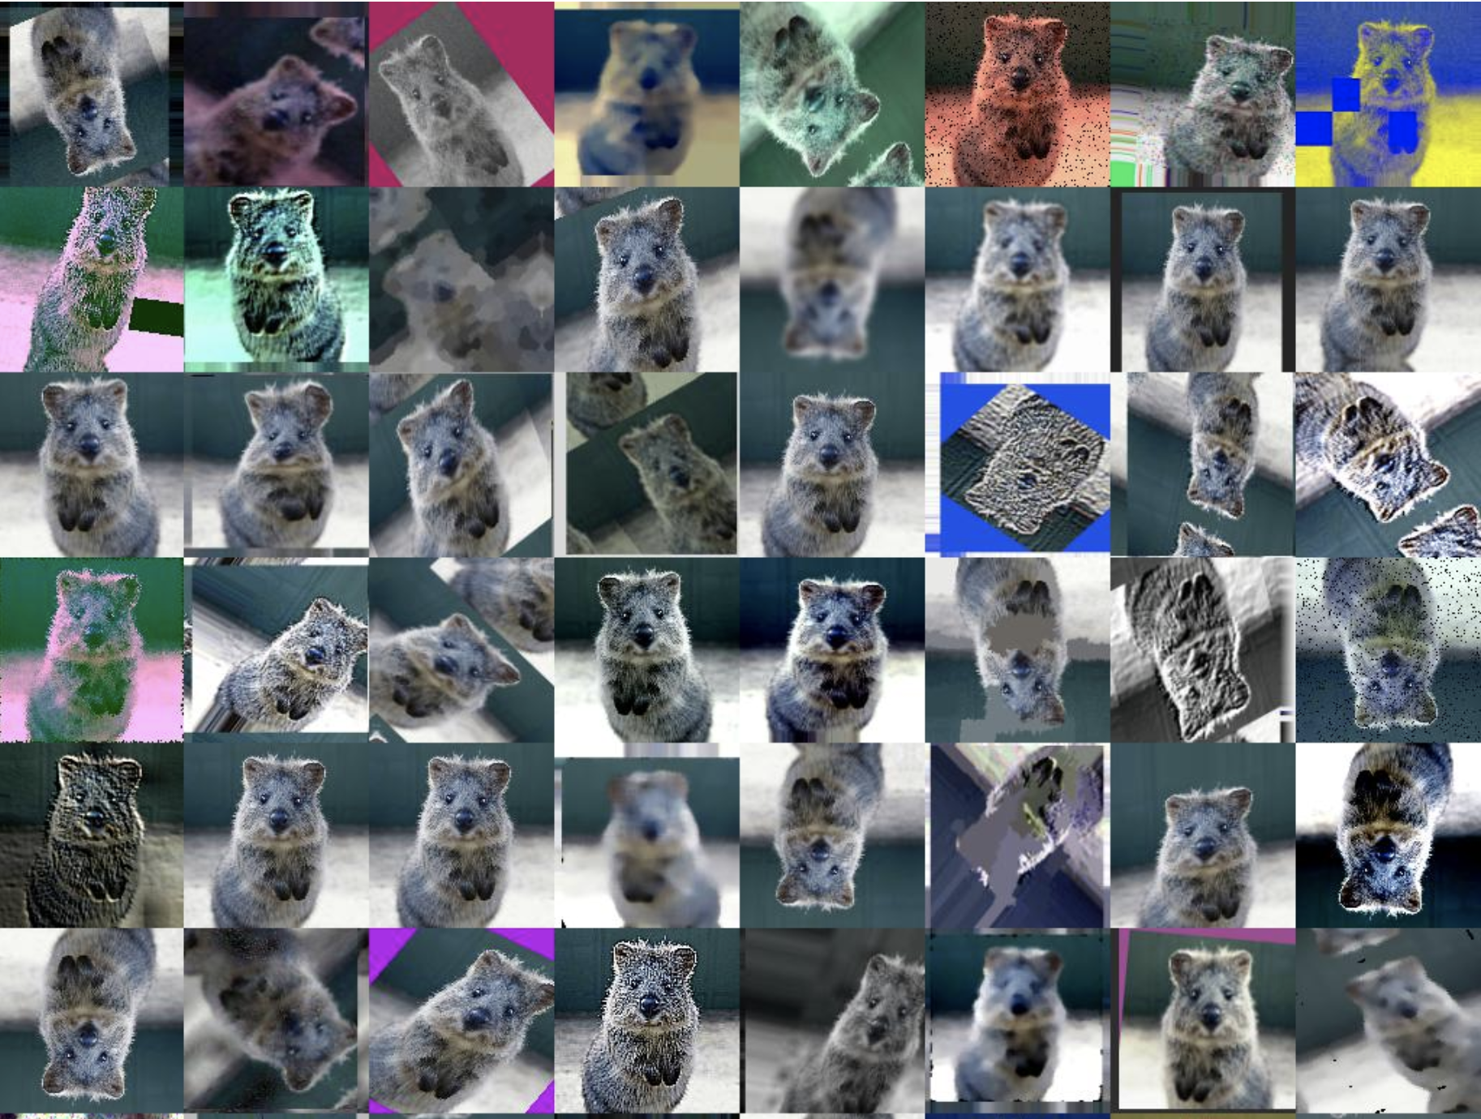
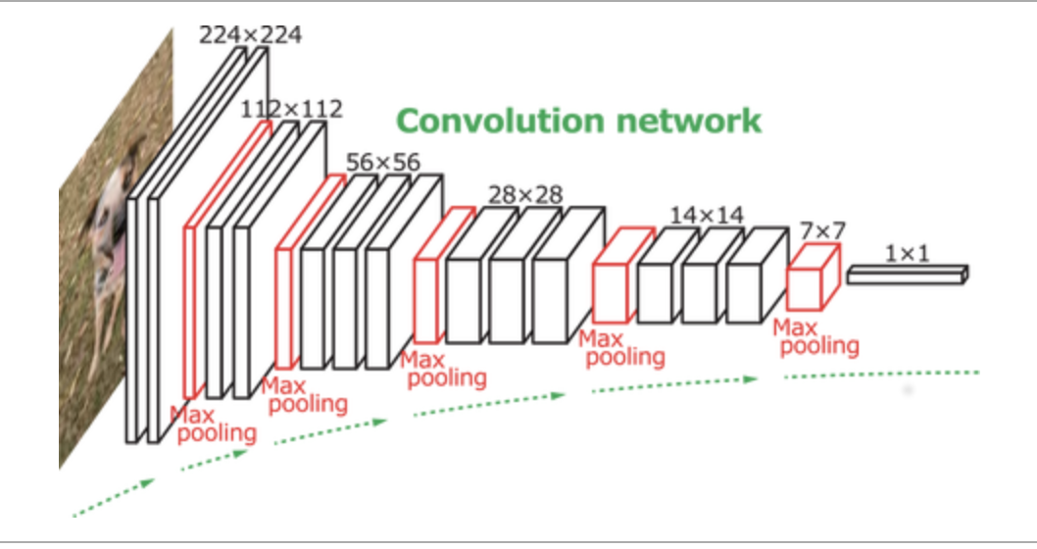
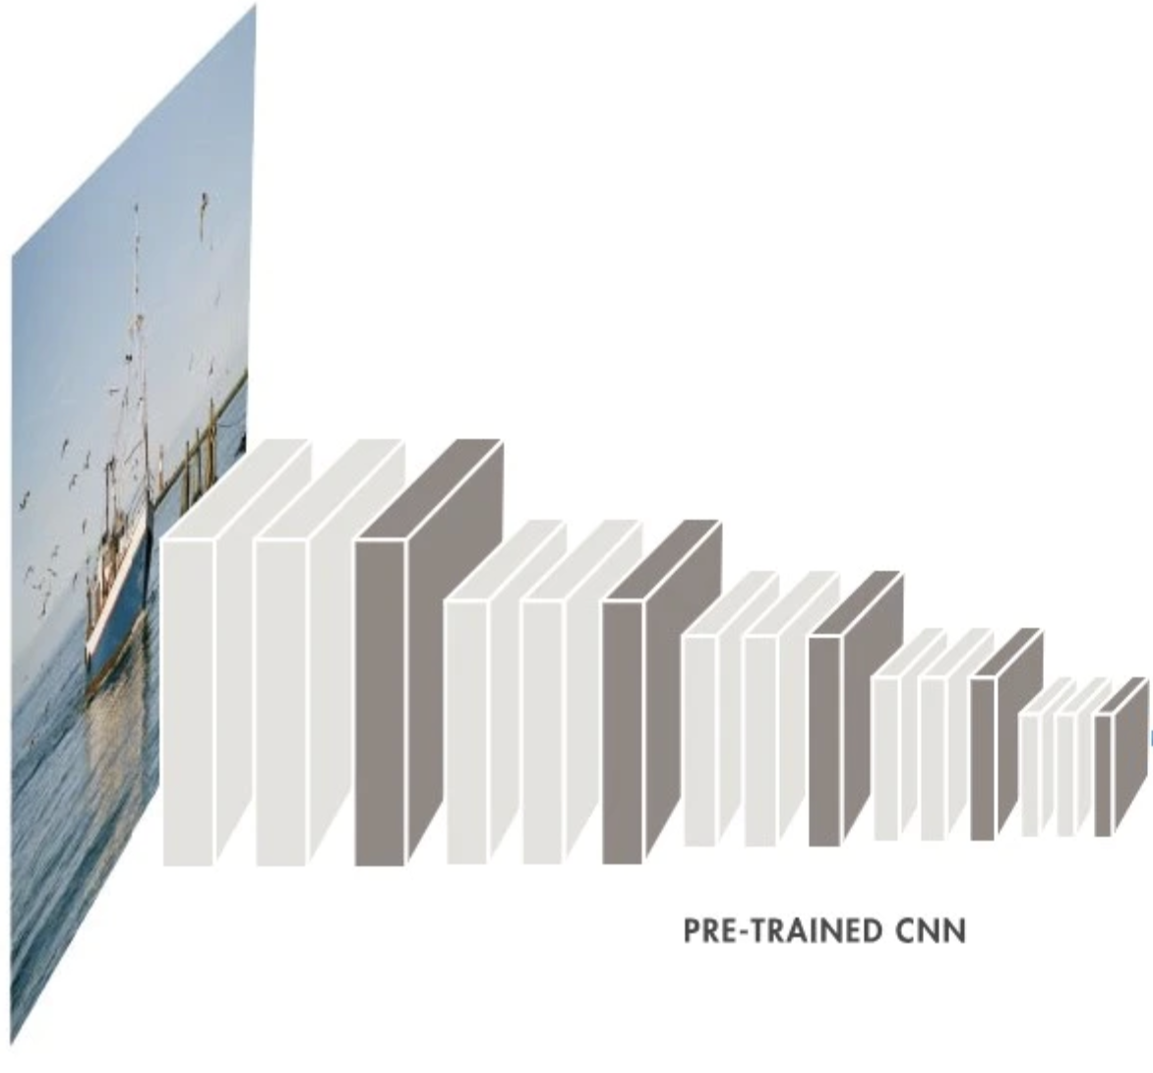
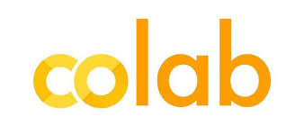
What is in the model?
Extracted and cleaned 4,000 images from Google images (2,000 Heroes and 2,000 Villains)
Extracted and cleaned 4,000 images from Google images (2,000 Heroes and 2,000 Villains)
Francois Chollet’s CNN model
Francois Chollet’s CNN model
Keras - Neural Networks API
Keras - Neural Networks API
Added a pre-trained convnet model (VGG16)
Added a pre-trained convnet model (VGG16)
Perform image augmentation
Perform image augmentation
Run model on Google Colab (GPU)

Slide 6
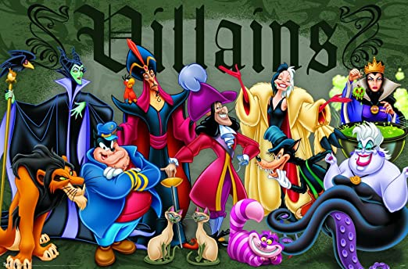
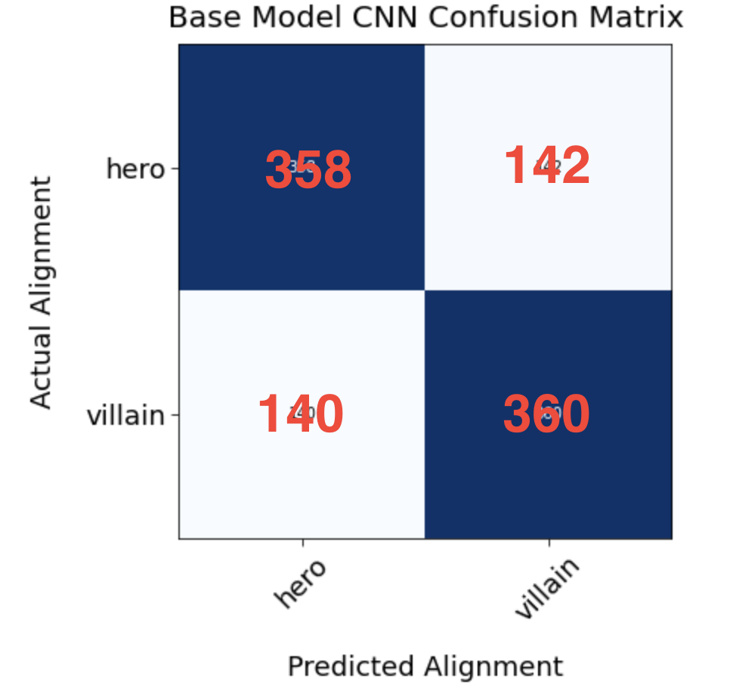
Confusion Matrix: Prediction of Villains
Validation Set:
Accuracy =72.5%

Slide 7
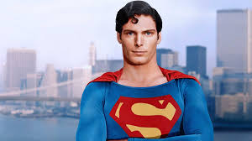
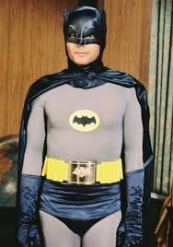
Can the model predict Heroes(Good) or Villain (Evil)?
Villain Score (level of Villainy)
0.00
HEROES
1.00
VILLAINS
Classic Superman
Classic Batman
Hero/Good
0.3144
Hero/Good
0.19511

Slide 8
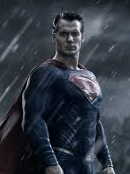
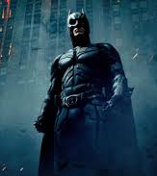
Today’s version of the same heroes.
Villain/Evil
0.6698
Villain/Evil
0.8027

Slide 9
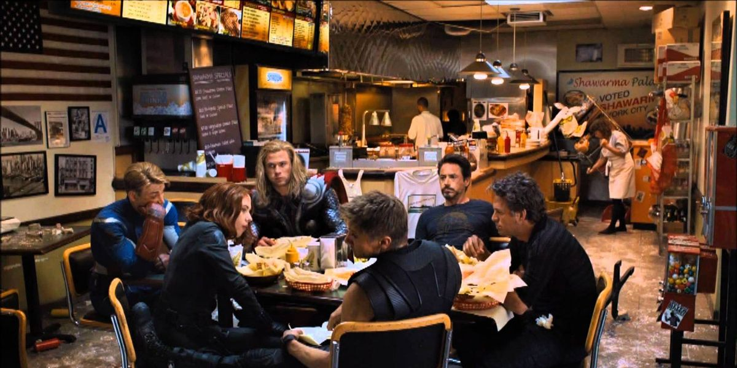
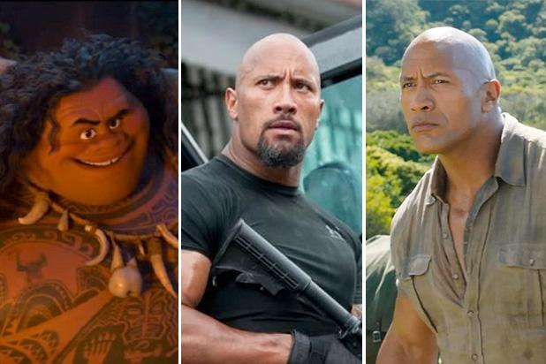
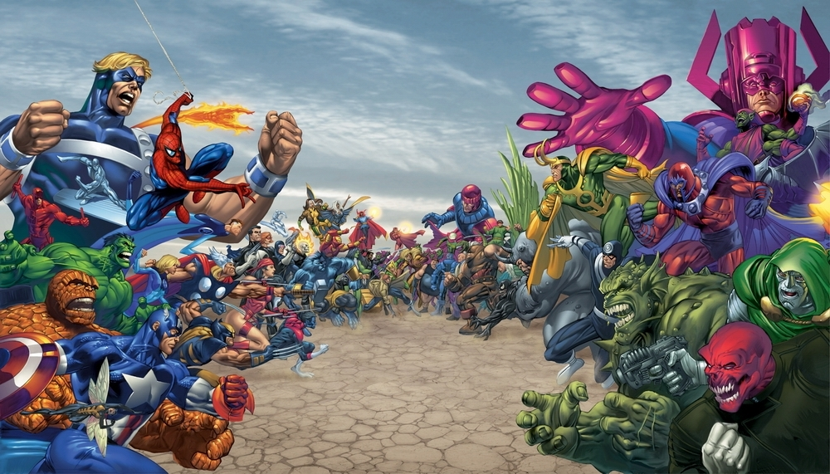
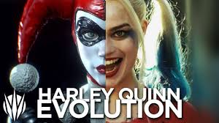
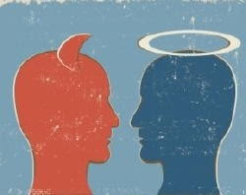
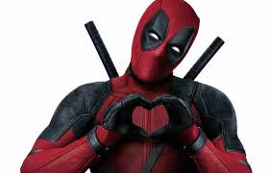
In Conclusion:
Classifying Heroes and Villains would be easier using traditional archetypes of Good and Evil.
Classifying Heroes and Villains would be easier using traditional archetypes of Good and Evil.
Current perceptions of heroes make it harder to distinguish heroes and villain. Many modern heroes are a blend of both.
Current perceptions of heroes make it harder to distinguish heroes and villain. Many modern heroes are a blend of both.
Popularity of antiheroes such as Harley Quinn makes it difficult to predict, since she is good and bad(depending on her mood).
Popularity of antiheroes such as Harley Quinn makes it difficult to predict, since she is good and bad(depending on her mood).
Model can identify most heroes including antiheroes at a 72.5% accuracy.
Model can identify most heroes including antiheroes at a 72.5% accuracy.
Model can help to validate the level of heroism or villainism for casting actors and creating animated characters.

Slide 10
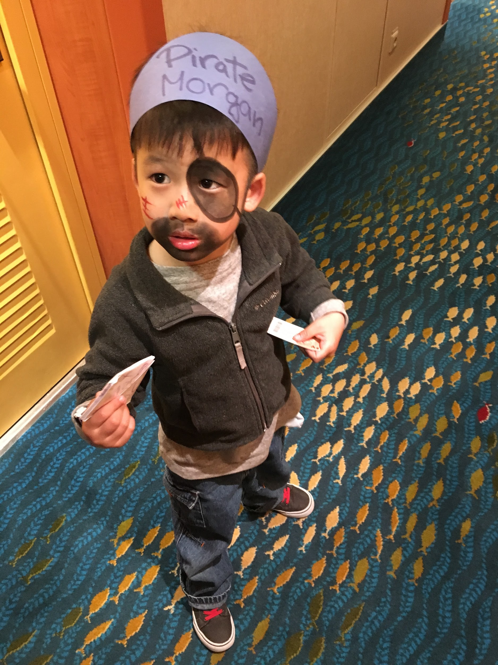
But wait “True Believers”!, let’s see one more….
The model can identify heroes dressed like villain’s(Antiheroes).
Hero/Good
(sometimes)
(sometimes???)

Slide 11
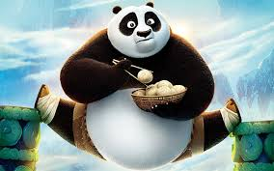
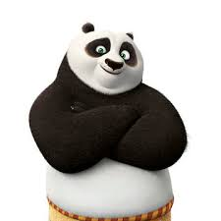
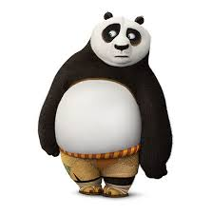



QUESTIONS???
johnpang.dev@gmail.com
johnypang
yjpang

Slide 12
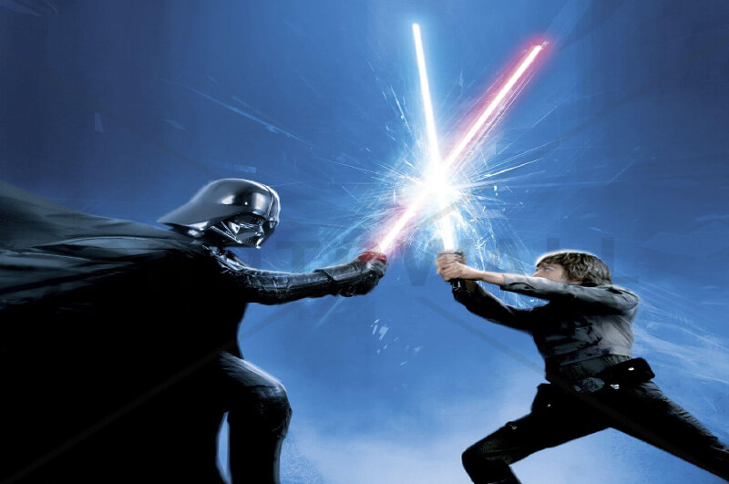
Future work:
Add more Antihero images and optimize identification.
Add more images from other countries.
Experiment with converting image to black and white images.
Create a timeline of the evolution of heroes and villains.

